Slide 1

House Price Prediction Using Machine Learning and Data Mining Techniques

Slide 2
Group 7
RITIKA KALYANI - 811289983
AKHIL SELIVERI – 811290035
NAVATH VAMSHI KRISHNA - 811303145
RAJESH KATHERASALA - 811314095

Slide 3

Introduction
Housing has long been one of the most essential human needs, evolving alongside food and water as a cornerstone of survival. Over time, the demand for homes has surged, driven not only by personal necessity but also by investment interests. People purchase homes for three primary reasons: as a place to live, for income-generating properties, or as long-term investments. This increasing demand, fueled by rising living standards and economic factors, has led to a continual rise in housing prices. Factors such as location, neighborhood amenities, and local market conditions play a critical role in influencing this trend. As a result, accurate forecasting of house prices has become an essential tool for a variety of stakeholders, helping them make informed decisions within their financial constraints and desired property features.
Predictive models, particularly those based on machine learning techniques such as support vector regression, neural networks, K-Nearest Neighbors, and ensemble methods like Random Forest and AdaBoost, have become crucial in this field. These models analyze past data to identify patterns and relationships, allowing for more detailed and precise market appraisals. Real estate websites like Zillow and Redfin, for instance, use these models to offer home appraisals, helping buyers and sellers understand market trends and property values. Additionally, lenders use price predictions to assess the risk of mortgages and adjust loan terms accordingly. Urban planners use these models for affordable housing initiatives, while developers utilize them to identify promising areas and set competitive prices. Furthermore, real estate investors rely on predictive models to pinpoint high-growth regions and maximize returns on investments, whether through renting or reselling properties.

Slide 4
Buyers: Predictive pricing enables buyers to budget accurately, ensuring that they select homes that fit both their financial capacity and personal preferences. Homebuyers can avoid overspending and prioritize homes that align with their lifestyle needs.
Developers: Accurate price forecasting allows developers to make informed decisions on property pricing, project timelines, and the type of properties to develop, all of which can lead to better investment outcomes. By understanding market trends, developers can target locations with high growth potential.
Lenders: Banks and financial institutions rely on property price predictions to assess risks associated with mortgages. Understanding price trends helps them adjust interest rates and terms based on market conditions, ensuring that loans remain manageable for borrowers and profitable for lenders.

Slide 5
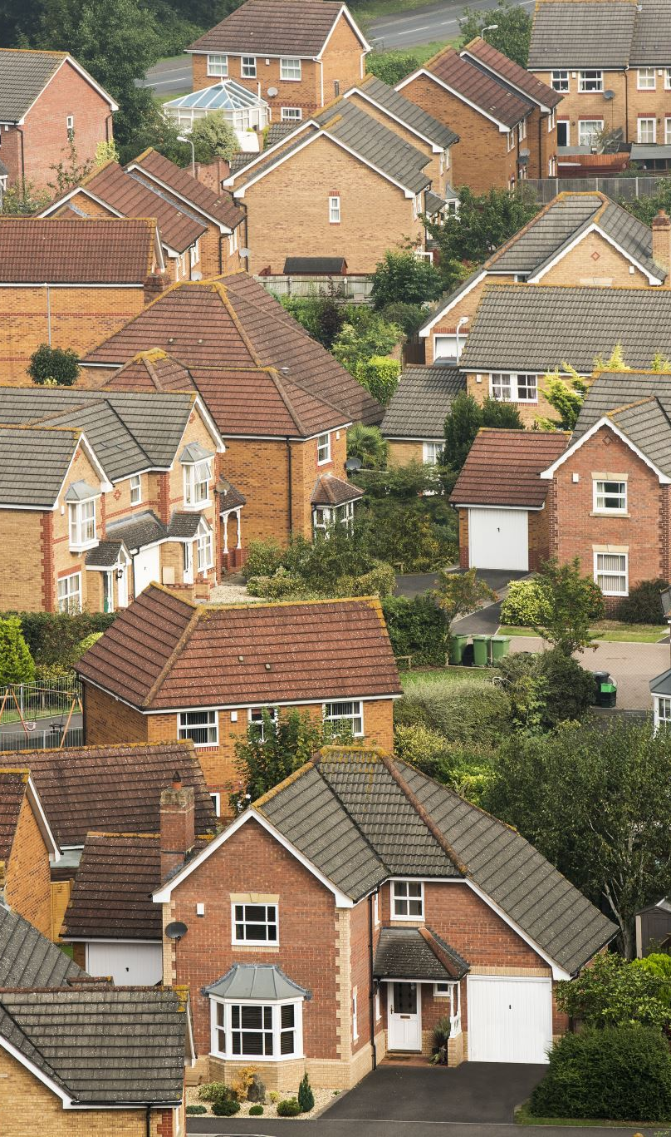
Background
Forecasting housing prices in metropolitan areas is challenging due to the complex mix of factors that impact property values. Social and economic variables play a major role in shaping housing trends, but broader macroeconomic conditions and future price expectations can also drive significant shifts in property values. These dynamic influences make predicting price changes particularly difficult, as market conditions are constantly evolving. Data mining techniques provide a way to analyze historical pricing data and identify relevant variables, helping create predictive models that can estimate future price trends. These models are invaluable for stakeholders, including buyers, sellers, financial institutions, and real estate professionals, as they offer insights critical for making informed decisions.
To build these models, Python libraries like Scikit-Learn and Pandas are commonly used for data processing and model development. Integrated development environments (IDEs) such as Jupyter Notebook facilitate efficient coding, while MySQL databases help manage and store large datasets. In most cases, standard computing resources are sufficient, although exceptionally large datasets or complex models may require more advanced hardware. Proficiency in data analysis, machine learning techniques, and tools for visualization and spatial data management is crucial for successfully developing these predictive models. These skills ensure that the models provide accurate and relevant predictions, helping stakeholders navigate the ever-changing housing market.

Slide 6
Social and Economic Factors: Income levels, employment rates, demographic shifts, and inflationary pressures directly influence housing demand. Economic downturns, for instance, may reduce people’s ability to purchase homes, driving prices down. Conversely, economic growth and rising wages may push demand and prices higher.
Market Variability: Housing prices exhibit significant variability across regions due to different local conditions. Urban areas typically experience more volatile price changes due to higher demand, whereas rural areas tend to have more stable but slower-growing markets. Each market must be modeled individually to capture these nuances
Technological Role: Machine learning models can efficiently process vast amounts of data and recognize patterns that would be impossible for humans to identify manually. These models analyze historical data, identify relationships among features, and predict future trends with increased accuracy, making them invaluable tools for housing price forecasting.
Tools Used:
Python Libraries: Libraries like Pandas handle large datasets by cleaning and organizing raw data, while Scikit-Learn offers a range of machine learning algorithms to build models. These tools streamline the data processing and modeling stages.
Development Tools: Google Colab enables step-by-step code development and testing, making it an essential tool for experimenting with different models.

Slide 7

Project Description
The primary objective of this research is to build a machine learning model capable of predicting residential property values based on key features such as location, size, age, and amenities. This model aims to provide buyers, sellers, and real estate agents with accurate price estimates to help them make informed financial decisions. Various machine learning techniques, including regression models and tree-based algorithms, will be explored throughout the project to address the complexity of housing price data, which can fluctuate significantly due to numerous economic and local factors.
The project faces several key challenges, including data quality issues, the high variance in property prices, and ensuring the model's interpretability so that the results are accessible to users. One of the main contributions of the project will be the development of advanced feature engineering methods, especially for variables like location, which have a profound impact on property costs. Additionally, new modeling approaches may be employed to enhance prediction accuracy and make the results more relevant to end-users. The project will be organized in stages, including data preprocessing, model selection, training, optimization, evaluation, and documentation. Each team member will focus on specific tasks within these stages to streamline the workflow and leverage individual expertise, ensuring the development of a comprehensive and reliable predictive model.

Slide 8

Key Features: The model incorporates multiple features such as property location, square footage, age, number of rooms, amenities, and nearby facilities (e.g., schools, parks). These features are chosen based on their significant influence on property value.
Goal: The goal of the project is to provide stakeholders with a reliable, data-driven pricing model. Buyers, sellers, and developers can use the model’s predictions to make decisions that maximize value and minimize risk.
Challenges Addressed:
Data Quality: Cleaning and preprocessing missing or inaccurate data are critical to ensuring that the model performs optimally.
Model Complexity: Advanced models like Random Forest and AdaBoost are selected to handle complex relationships in the data, while ensuring that the predictions remain interpretable for practical use.
Scalability: The model is designed to handle datasets of varying sizes, ensuring its robustness and flexibility across different market scenarios.

Slide 9
Related Works
Real-world applications and academic research provide essential insights into the effectiveness of predictive modeling for the housing market. Platforms like Zillow and Redfin use machine learning models to offer real-time home appraisals, helping buyers and sellers better understand market trends and property values. These models analyze various property features, such as location, size, and condition, to provide accurate estimates that reflect current market conditions. Similarly, real estate developers and investors rely on predictive models to identify high-growth areas and determine optimal pricing strategies, enabling them to make more informed investment decisions.
Academic studies also contribute significantly to the development of predictive models for housing prices. Research such as that published in IEEE Access (2022) has demonstrated the superiority of ensemble methods like Random Forest in capturing complex relationships within housing data. These studies validate the use of machine learning techniques to predict housing prices more accurately than traditional methods, especially in dynamic markets. By analyzing historical price data and relevant economic indicators, predictive models offer valuable insights for stakeholders across the housing market, providing tools for smarter decision-making and enhanced market efficiency.

Slide 10
Zillow and Redfin: These major real estate platforms use predictive models to provide real-time appraisals, helping buyers and sellers understand market trends. These models are continuously updated to reflect current market conditions and buyer sentiment.
Academic Studies: Research, such as IEEE Access (2022), has shown that ensemble techniques like Random Forest are more accurate than linear regression for modeling house prices. By combining predictions from multiple models, ensemble methods can capture more complex relationships between features.
Builders and Developers: Predictive models help builders identify high-growth areas by analyzing patterns in price fluctuations, demand, and amenities. This allows them to invest in areas with higher returns on investment, whether for new developments or renovations.
Example: By using historical price data and machine learning algorithms, investors can accurately predict which properties will yield the highest returns over time, helping them optimize their portfolios.

Slide 11

Problem Definition
The primary goal of this study is to develop a machine learning model that can reliably predict house prices based on several important parameters. The model is designed to estimate the selling price of residential homes using input features such as location, property size, age, and amenities. This problem is framed as a supervised regression task, where the objective is to predict a continuous value—the selling price. Some of the major challenges faced in this process include managing the variability in housing data, ensuring the interpretability of the model, and incorporating the socio-economic and market-driven factors that influence housing prices. To be effective, the model must provide accurate forecasts that help stakeholders, such as homebuyers, sellers, investors, and real estate brokers, make informed decisions.
Key challenges in addressing the issues with this project include dealing with the variability and quality of the data. Real estate data is often inconsistent, with missing or incorrect entries that can negatively affect the accuracy of predictions. There is also substantial variation in housing prices due to local characteristics, such as neighborhood quality and proximity to amenities, making precise forecasting difficult. Managing diverse information is another challenge, as housing data typically contains both numerical and categorical variables. These need specialized preprocessing techniques to be suitable for machine learning algorithms. Lastly, ensuring the interpretability of the model is crucial, particularly when using complex models like Random Forest or CatBoost. Stakeholders need to understand how the model's predictions are derived to make confident, informed decisions.

Slide 12

Data Variability: Housing data can be inconsistent, with missing values, outliers, or incorrect entries that can negatively impact model performance. Models must be designed to handle these inconsistencies without sacrificing accuracy.
Feature Diversity: Housing data often contains both categorical (e.g., neighborhood type, property style) and numerical (e.g., square footage, price) features. These different types of data need specialized preprocessing methods to be compatible with machine learning models.
Model Complexity: Advanced machine learning algorithms like Random Forest and CatBoost offer high accuracy but lack transparency, making it difficult for non-technical stakeholders to trust the results. It is essential to balance accuracy with explainability.
Solutions:
Data Preprocessing: Missing data is imputed, and outliers are either removed or corrected to reduce bias. Data is then normalized or standardized to ensure that features contribute equally during training.
EDA: Exploratory Data Analysis (EDA) identifies key trends and patterns, allowing for informed decisions on feature selection.
Interpretability: Using tools like SHAP and LIME helps explain model predictions, ensuring that stakeholders can understand how input features impact the output.

Slide 13

Data Analysis
Exploratory Data Analysis (EDA) is a crucial step in the data science process, providing a comprehensive understanding of the dataset before applying machine learning models. It involves visualizing and summarizing the dataset to identify patterns, trends, and potential outliers that may influence the accuracy of the model. By using techniques such as scatter plots, histograms, and box plots, EDA helps detect relationships between different variables, allowing for better feature selection and engineering. Understanding these relationships early on ensures that the model is trained on the most relevant and impactful data, ultimately leading to improved predictions.
In addition to identifying patterns, EDA also plays a key role in uncovering anomalies or inconsistencies in the data. Missing values, duplicate entries, or erroneous data points can significantly affect the performance of the model, and EDA allows these issues to be addressed before further analysis. This process also helps in understanding the distribution of the data, which is important for selecting appropriate modeling techniques. By conducting a thorough EDA, data scientists can make informed decisions on how to preprocess the data, which features to keep or modify, and how to handle outliers or skewed distributions, ensuring that the model is built on a solid foundation.

Slide 14
Data Visualization: Scatter plots and histograms help visualize price trends across different locations and property types. Identifying outliers and trends early on can influence which features are kept or discarded.
sns.boxplot(x='MSZoning', y='SalePrice', data=house_data)
plt.title('Distribution of SalePrice across MSZoning')
plt.xlabel('MSZoning')
plt.ylabel('SalePrice')
plt.xticks(rotation=45)
plt.show()
Correlation Analysis: Heatmaps visually demonstrate how strongly different features, like property size and price, are correlated. This helps prioritize the most relevant features for modeling.
numerical_dataset = house_data.select_dtypes(include=['number'])
plt.figure(figsize=(12, 6))
sns.heatmap(numerical_dataset.corr(),
cmap = 'BrBG',
fmt = '.2f',
linewidths = 2,
annot = True)
Feature Engineering: Categorical features such as neighborhoods or property types are transformed using one-hot encoding, enabling the model to process them efficiently.

Slide 15
Modeling
Splitting a dataset into 80% for training and 20% for testing is a common practice in machine learning. This split ensures that the model is trained on a majority of the data while being evaluated on a separate, unseen portion to assess its generalization ability. This technique helps to prevent overfitting, ensuring the model does not perform well only on the data it was trained on, but also on new, unseen data.
Why Split the Data?
Training Set (80%): This portion of the data is used to train the machine learning model. The model learns patterns, correlations, and structures from the training data.
Testing Set (20%): The testing set is not used during the training phase. It serves as an independent dataset that allows you to evaluate the model's performance on data it has never seen before. This helps in understanding how well the model will perform on unseen, real-world data.

Slide 16
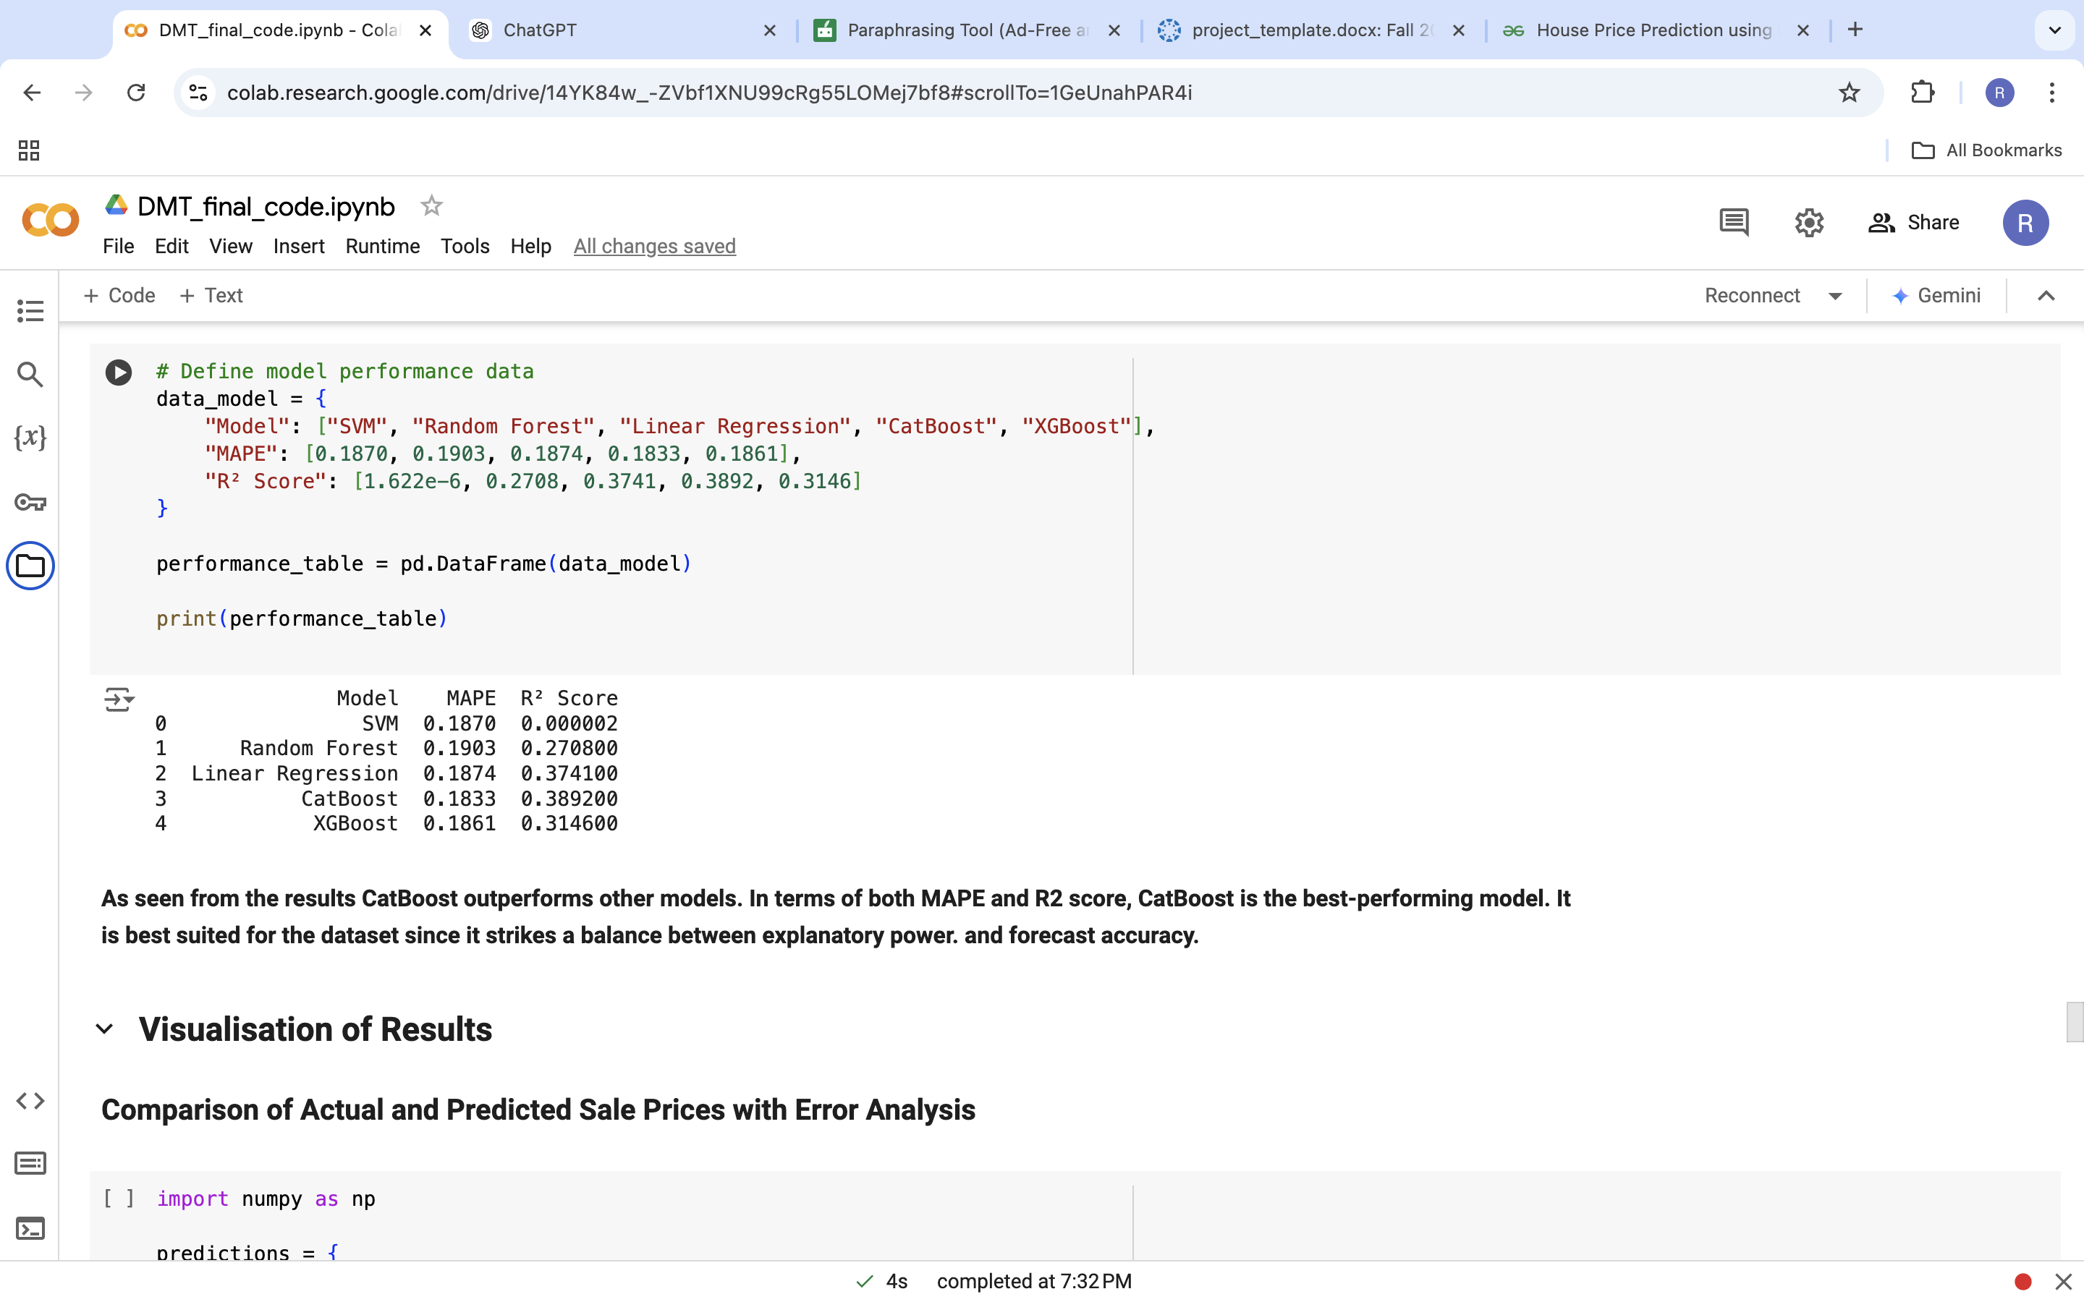
1. Support Vector Machine (SVM)
Support Vector Machine (SVM) is a supervised learning model commonly used for classification and regression tasks. It works by finding a hyperplane that best divides a dataset into different classes. For regression, SVM tries to fit the best line within a margin of tolerance (epsilon). It works well for smaller datasets with complex, non-linear relationships.
2. Random Forest Regression
Random Forest Regression is an ensemble learning method that creates multiple decision trees and aggregates their outputs to make predictions. It reduces overfitting and improves the accuracy of predictions by averaging multiple models. Random Forest is highly effective for handling complex datasets with many features and can model non-linear relationships well.
3. Linear Regression
Linear Regression is one of the simplest and most widely used algorithms for predicting continuous values. It models the relationship between input features and the target variable as a straight line, making it easy to understand. It assumes linearity, so it’s less effective if the data has complex non-linear relationships.
4. CatBoost Classifier
CatBoost (Categorical Boosting) is a gradient boosting algorithm that handles categorical data efficiently without the need for explicit encoding. It’s known for its accuracy and speed and performs well with unprocessed categorical variables, making it suitable for real-world data where categorical features are prevalent.
5. XGBoost Regressor
XGBoost (Extreme Gradient Boosting) is an optimized version of gradient boosting that enhances performance through parallelization and regularization. It’s one of the top-performing algorithms in machine learning competitions and is known for its accuracy, speed, and scalability. It’s particularly useful for large datasets and complex regression tasks.

Slide 17
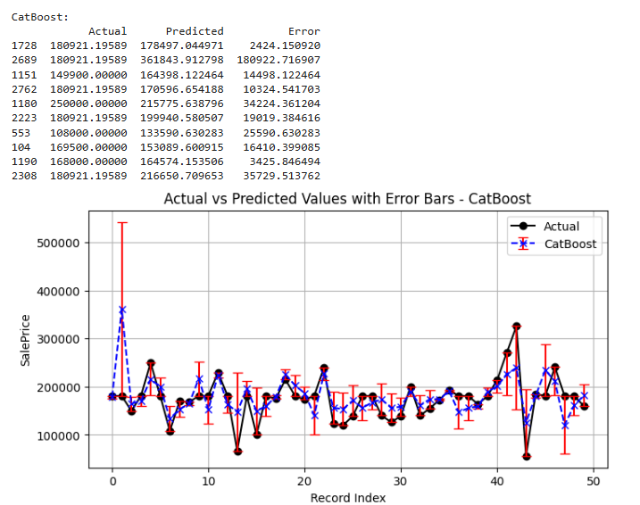
Results
As seen from the results CatBoost outperforms other models. In terms of both MAPE and R2 score, CatBoost is the best-performing model. It is best suited for the dataset since it strikes a balance between explanatory power. and forecast accuracy.
With improved accuracy and less prediction uncertainty, CatBoost exhibits the highest overall performance.

Slide 18

Future Works
The project holds significant potential for future enhancement and growth, particularly in integrating real-time data for more dynamic and accurate predictions. By incorporating economic indicators such as GDP growth, interest rates, or inflation, the model can adapt to market changes and provide more up-to-date forecasts. Additionally, real-time data feeds from housing markets, including current listings and sales, could make the model more responsive to immediate market shifts, allowing stakeholders to make timely decisions. These enhancements would ensure that the model remains relevant and practical in an ever-evolving housing market.
Another key area for expansion is the model’s applicability to international markets. By adjusting the model to accommodate regional differences, such as varying property laws, economic conditions, and market structures, the tool could be adapted for global use. Furthermore, the development of interactive dashboards and user-friendly interfaces would make the model more accessible to a broader audience. These dashboards would allow users to explore various scenarios, interact with model outputs, and visualize predictions, improving decision-making and enhancing the overall usability of the system. With these improvements, the project could extend its reach and impact across different geographies and user groups.

Slide 19
Dynamic Data Integration: Incorporating real-time data like economic conditions, interest rates, or housing demand would ensure the model adapts to current market changes and remains accurate over time.
Global Applicability: The model can be expanded to handle data from international markets, adjusting for regional factors like property laws, taxation, and local demand.
Interactive Dashboards: By integrating with platforms like Dash, stakeholders can interactively explore model outputs, test scenarios, and visualize predictions, making the model more accessible and actionable.

Slide 20
References
Pratap, A., Rastogi, K., and Rajpoot, S., "House Price Prediction Using Machine Learning," IEEE Access, 2022.
Manjula, R., et al., "Real Estate Value Prediction Using Multivariate Regression Models," 2017.
GeeksforGeeks, "House Price Prediction Using Machine Learning in Python," 2024.
Li, Li, and Kai-Hsuan Chu. "Prediction of real estate price variation based on economic parameters." 2017 International Conference on Applied System Innovation (ICASI). IEEE, 2017.

